Slide 1
Software Testing and Quality Assurance (CST-311)
Department:- Computer Science & Engineering
Unit -2
Chapter 1
Lecture 1.2

Slide 2
Contents
What are Specification-Based or Black-Box techniques?
Types of Specification-Based or Black-Box techniques.
What are Structure-Based or White-Box Techniques?
Types of Structure-Based or White-Box Techniques.

Slide 3
What are Specification-Based Techniques or Black-Box Techniques?
This technique leverages the external description of the software such as technical specifications, design, and client’s requirements to design test cases.
The technique enables testers to develop test cases that provide full test coverage.
The Specification-based or black box test case design techniques are divided further into 5 categories. These categories are as follows:

Slide 4
Types of Specification Based Techniques
1. Boundary Value Analysis (BVA)
2. Equivalence Partitioning (EP)
3. Decision Table Testing
4. State Transition Diagrams
5. Use Case Testing

Slide 5
Boundary Value Analysis (BVA)
Boundary value analysis is based on testing at the boundaries between partitions.
It includes maximum, minimum, inside or outside boundaries, typical values and error values.
It is generally seen that a large number of errors occur at the boundaries of the defined input values rather than the center.

Slide 6
Boundary Value Analysis (BVA)
Example:
Input condition is valid between 1 to 10
Boundary values 0,1,2 and 9,10,11

Slide 7
Equivalence Class Partitioning
Equivalent Class Partitioning allows you to divide set of test condition into a partition which should be considered the same.
This software testing method divides the input domain of a program into classes of data from which test cases should be designed.
It allows you to Identify valid as well as invalid equivalence classes.

Slide 8
Equivalence Class Partitioning
Example:-
Input conditions are valid between :-
1 to 10 and 20 to 30
Hence there are five equivalence classes :-
-- to 0 (invalid)
1 to 10 (valid)
11 to 19 (invalid)
20 to 30 (valid)
31 to --- (invalid)
You select values from each class, i.e.,
-2, 3, 15, 25, 45

Slide 9
Decision Table
A decision table is also known as to Cause-Effect table.
This software testing technique is used for functions which respond to a combination of inputs or events. The first task is to identify functionalities where the output depends on a combination of inputs.
For every function, you need to create a table and list down all types of combinations of inputs and its respective outputs.

Slide 10
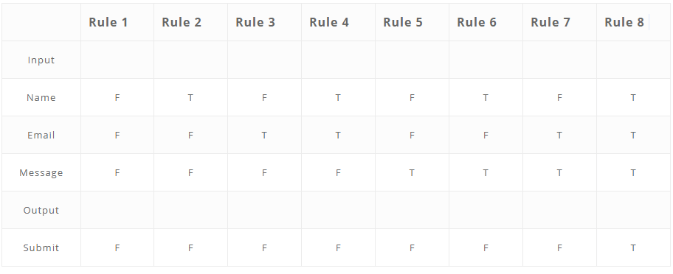
Decision Table
Example: A submit button in a contact form is enabled only when all the inputs are entered by the end user.

Slide 11
State Transition
In State Transition technique changes in input conditions change the state of the Application Under Test (AUT).
This testing technique allows the tester to test the behavior of an AUT.
The tester can perform this action by entering various input conditions in a sequence.
In State transition technique, the testing team provides positive as well as negative input test values for evaluating the system behavior.

Slide 12
State Transition
Example:
In the following example, if the user enters a valid password in any of the first three attempts the user will be able to log in successfully.
If the user enters the invalid password in the first or second try, the user will be prompted to re-enter the password.
When the user enters password incorrectly 3rd time, the action has taken, and the account will be blocked.

Slide 13
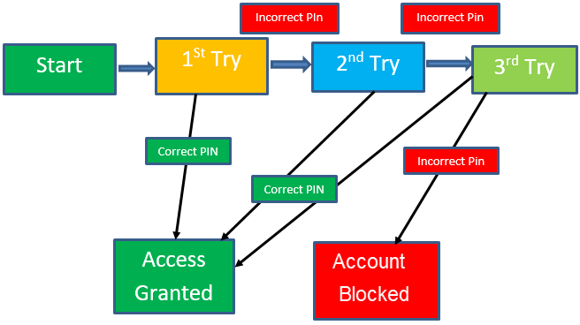
State Transition Diagram

Slide 14
Use Case Testing
A use case is a description of a particular use of the software by a user.
In this technique, the test cases are designed to execute different business scenarios and end-user functionalities.
Use case testing helps to identify test cases that cover the entire system.

Slide 15
What are Structure-Based or White-Box Techniques?
The structure-based or white-box technique design test cases based on the internal structure of the software.
This technique exhaustively tests the developed code.
Developers who have complete information of the software code, its internal structure, and design help to design the test cases.

Slide 16
Types of Structure-Based or White-Box Techniques
This technique is further divided into five categories.:-
1. Statement Testing & Coverage
2. Decision Testing Coverage
3. Condition Testing
4. Multiple Condition Testing
5. All Path Testing

Slide 17
Types of Structure-Based or White-Box Techniques
1. Statement Testing & Coverage
This technique involves execution of all the executable statements in the source code at least once.
The percentage of the executable statements is calculated as per the given requirement.
This is the least preferred metric for checking test coverage.

Slide 18
Types of Structure-Based or White-Box Techniques
2. Decision Testing Coverage
This technique is also known as branch coverage is a testing method in which each one of the possible branches from each decision point is executed at least once to ensure all reachable code is executed.
This helps to validate all the branches in the code.
This helps to ensure that no branch leads to unexpected behavior of the application.

Slide 19
Types of Structure-Based or White-Box Techniques
3. Condition Testing
Condition testing also is known as Predicate coverage testing, each Boolean expression is predicted as TRUE or FALSE.
All the testing outcomes are at least tested once.
This type of testing involves 100% coverage of the code. The test cases are designed as such that the condition outcomes are easily executed.

Slide 20
Types of Structure-Based or White-Box Techniques
4. Multiple Condition Testing
The purpose of Multiple condition testing is to test the different combination of conditions to get 100% coverage.
To ensure complete coverage, two or more test scripts are required which requires more efforts.
5. All Path Testing
In this technique, the source code of a program is leveraged to find every executable path.
This helps to determine all the faults within a particular code.

Slide 21
Summary
Boundary value analysis is based on testing at the boundaries between partitions.
Equivalence class partitioning method divides the input domain of a program into classes of data from which test cases should be designed.
Decision table technique is used for functions which respond to a combination of inputs or events.
A use case is a description of a particular use of the software by a user.

Slide 22
References
Text Books:
CemKaner, Jack Falk, HungQuoc Nguyen, Testing Computer Software, Wiley, (Second Edition).
William E. Perry,“ Effective Methods for Software Testing”, John Wiley & Sons.
Boris Beizer, ”Software Testing Techniques”, Second Edition, Dreamtech.
Reference Books:
Rex Black, “Managing the Testing Process: Practical Tools and Techniques for Managing Hardware and Software Testing”.
Daniel Galin, “Software Quality Assurance from Theory to Implementation”, Pearson Education.

Slide 23
THANK YOU

